Slide 1
Deep learning based computer-aided diagnosis systems for diabetic retinopathy
By
Anandhu Ashok
B160913EC

Slide 2
Introduction
Automatic diabetic retinopathy detection
Datasets
Performance metrics
Overview of deep learning
Literature survey
Interpreting
Gaps and future directions
Conclusion

Slide 3
INTRODUCTION
Diabetic Retinopathy(DR)- main causes of blindness, complications of diabetes.
Incurable at advanced stages.
Automated diagnosis systems to assist in early diagnosis of DR.

Slide 4
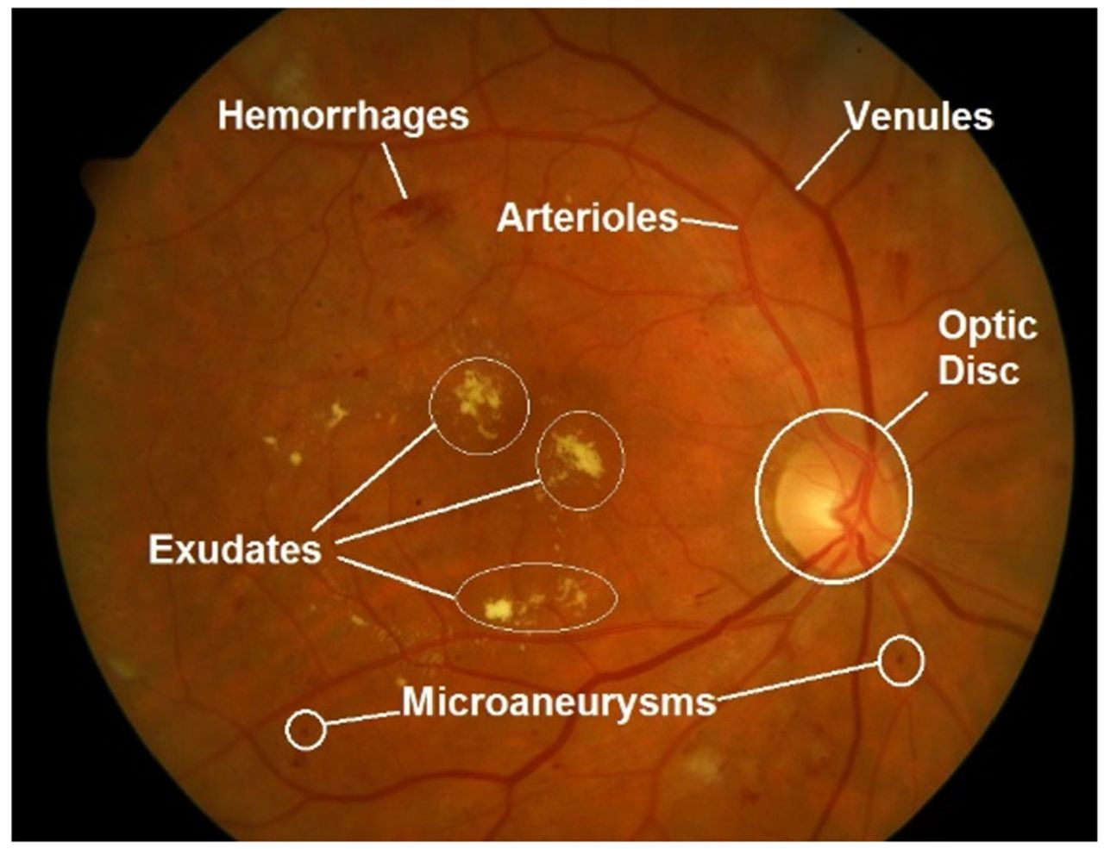
Automatic diabetic retinopathy detection
Types of lesions
Microaneurysms (MAs)-
Low vision, small
Hemorrhages(HMs)-
weak capillaries broken(bleeding)
Exudates (EXs)-
Two types
Hard Exudates-lipprotiens, white yellow
Soft Exudates-small,whitish grey
Optic disk(OD)-
Highest contast

Slide 5
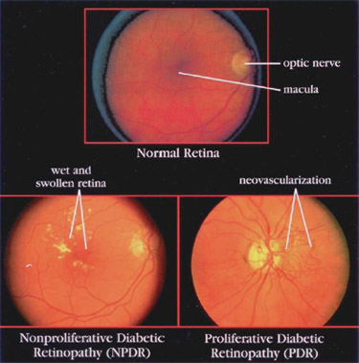
Stages of DR
Stages of DR
Non-proliferative(NPDR)
Proliferative(PDR)
Early stage
Damage small blood vessels.
Vessels discharge fluid and blood-retina swells.
At least one microaneurysm or hemorrhage with or without hard exudates.
Advanced stage, growth of new blood vessels.
Fragile new blood vessels bleed vitreous cavity
May lead to tractional retinal detachment.

Slide 6
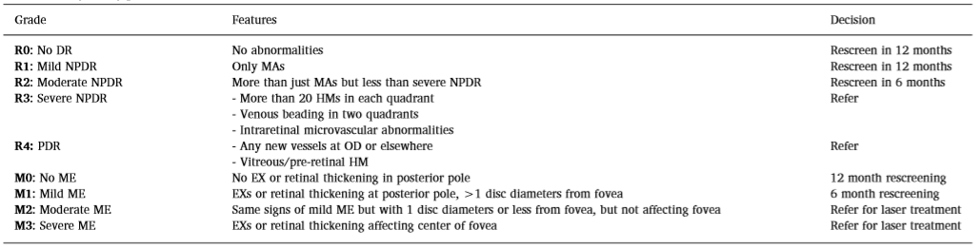
Grading of DR
Table 1-DR Scottish grading protocol

Slide 7
Detection tasks and general framework
DR detection
Supervised learning
Unsupervised learning
Lesion level-based detection
Image level-based detection
Lesion detection and/or segmentation
detected from fundus images
Exact area is localized
Lesion classification
Remove false positives
Image-screening task

Slide 8
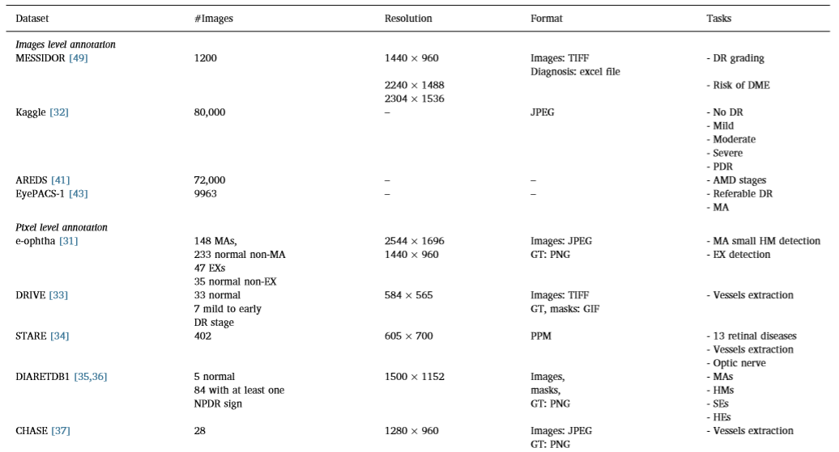
Datasets
Retinal fundus image datasets

Slide 9
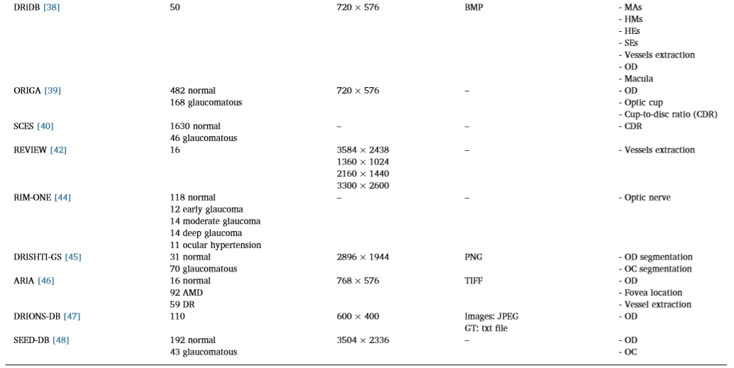
Table 2-Datasets for DR detection.

Slide 10
Performance metrics
ACCURACY=(TP+TN)/(TP+TN+FP+FN)
Sensitivity(Recall)=(TP)/(TP+FN)
Specificity =(TN)/(TN+FP)
Precision =(TP)/(TP+FP)
F = (2*Precision*Recall)/(Precision+Recall)
Receiver operating characteristic (ROC)= true positive rate against the false positive rate.
Area under the ROC curve(AUC)-0 & 1(performance)
Dice similarity coefficient (DSC)=2TP/(2TP+FP+FN)
0 & 1 (segmentation)

Slide 11

Overview of deep learning
Convolutional neural networks

Slide 12
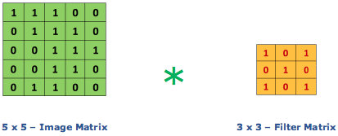
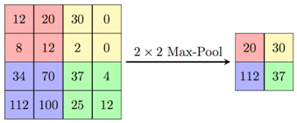


Slide 13
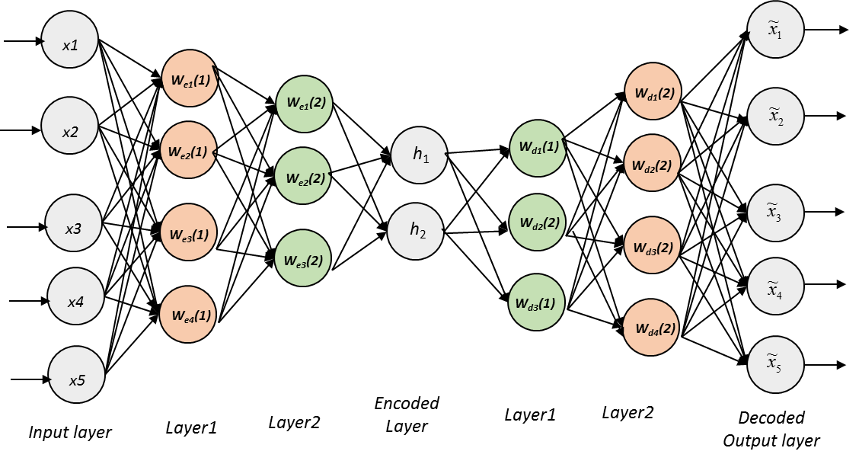
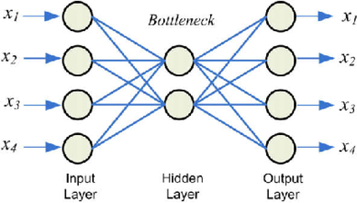
Autoencoder-based and stacked autoencoder methods
Autoencoder-based
Stacked autoencoder

Slide 14
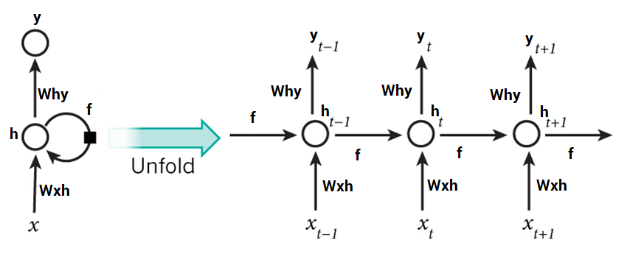
Recurrent neural networks

Slide 15
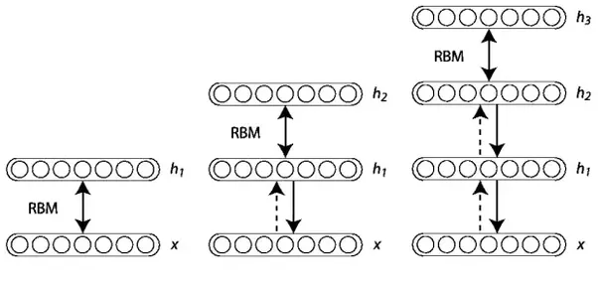
Deep belief networks

Slide 16
Literature survey
Based on the clinical importance of DR detection tasks:-
Retinal blood vessel segmentation
Optic disk localization and segmentation
Lesion detection and classification
Image-level DR diagnosis

Slide 17
Retinal blood vessel segmentation
Challenges :
Low contrast
Noisy background
Presence of pathologies(HMs & MAs)

Slide 18
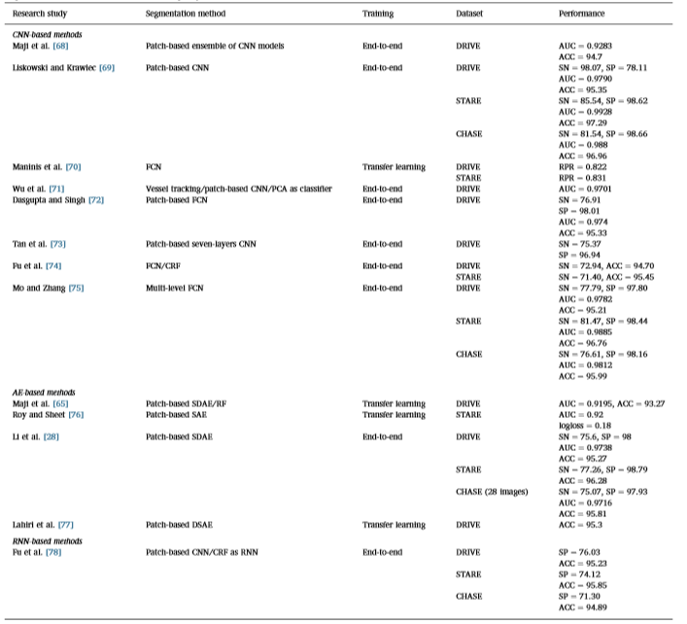
Table 5-Representative of works in diabetic retinopathy(DR) vessels detection

Slide 19
CNN
Liskowski and Krawiec
accuracy, AUC and sensitivity
Preprocessing
Training model using augmented dataset
Maji et al.
no preprocessing and augmentation

Slide 20
Optic disc feature
Two operations:
Localizing
Segmenting

Slide 21
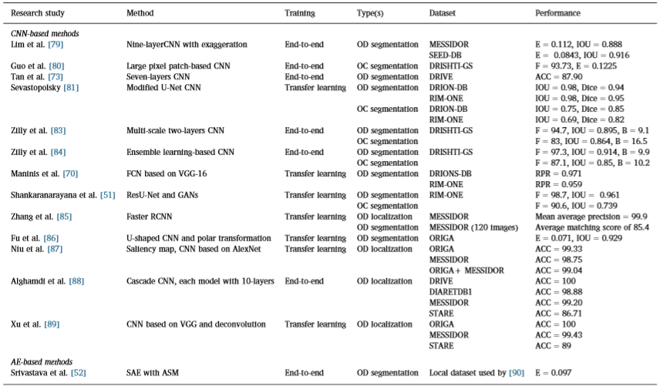
Table 4-OD detection works.

Slide 22
Difficult to determine best performance-all evaluated on different databases using different metrics.
Zhang et al.-faster RCNN gives best localization results(MESSIDOR dataset)
CNN better than SAE

Slide 23
Lesion detection and classification
Macula edema-Swelling of the macula
Exudate
Microaneurysms and hemorrhages

Slide 24
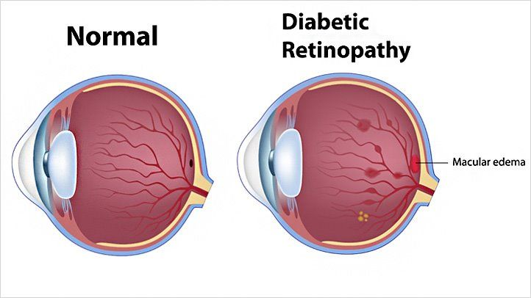
Macula edema
Diabetic macula edema:
CNN based
DBN

Slide 25
Research study | Method | Training | Lesion type(s) | Dataset | Performance
CNN
Abràmoff et al. | CNN inspired by AlexNet | End-to-end | Multistage DR/ME | MESSIDOR-2 | SN=100
Mo et al. | Cascaded FCRN | End-to-end | ME | HEI-MED | SN=92.55,F=84.99
Perdomo et al. | Patches based CNN model | Transfer learning | Multistage DR/ME | MESSIDOR | SN=56.5,SP=92.8 DME ACC=77
Burlina et al. | CNN-based on OverFeat | Transfer learning | Multistage AMD | NIH AREDS | SN=90.9–93.4 SP=89.9–95.6 ACC=92–95
Al-Bander et al. | CNN model with three conv. Blocks and one FC block | End-to-end | Multistage DR/ME | MESSIDOR | SN=74.7,SP=95 ACC=88.8
Ting et al. | CNN | End-to-end | AMD | 35948 images | SN=93.2,SP=88.7 AUC=0.931
DBN
Arunkumar and Karthigaikumar | DBN for training and multiclassSVM as classifier | End-to-end | AMD | ARIA | SN=79.32,SP=97.89 ACC=96.73
Table 5-Representative works for DME detection.

Slide 26
CNN>DBN
Abràmoff et al. better performance(Alexnet-like model)

Slide 27
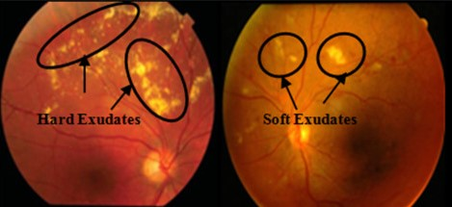
Exudate
All CNN based

Slide 28
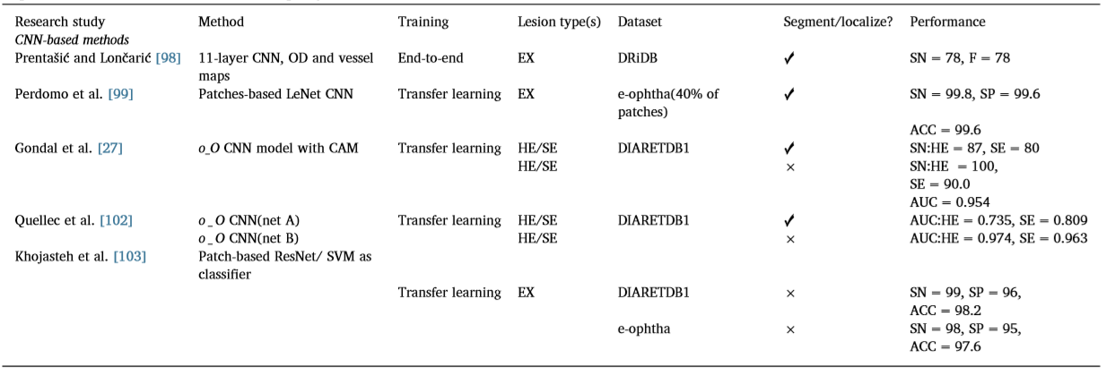
Table 6-Representative of works in diabetic retinopathy(DR) EX detection.
Gondal et al. and Quellec et al. -detect referable DR and lesions

Slide 29
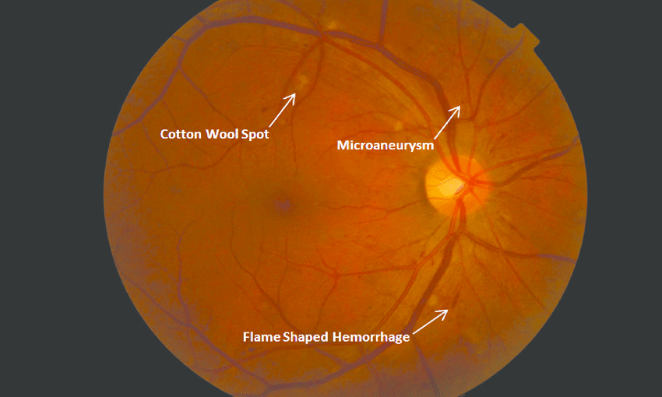
Microaneurysms and hemorrhages
MAs & HMs based on CNN & AE

Slide 30
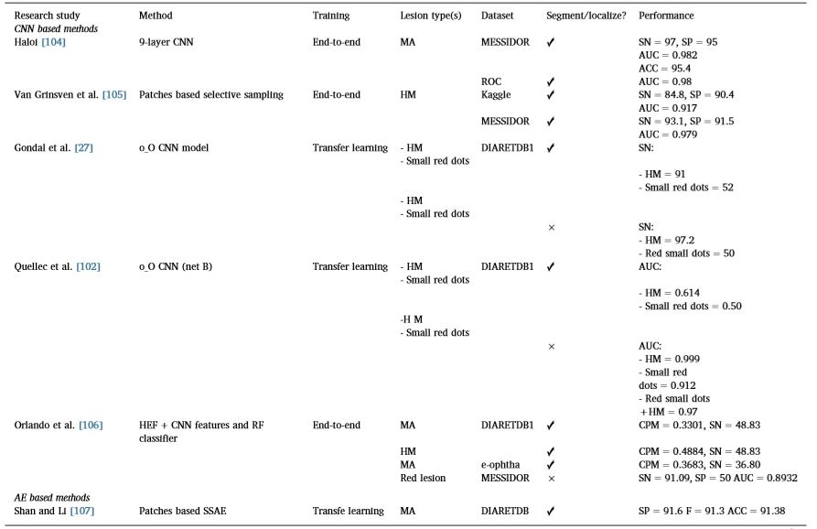
Table 8-Representative of works in diabetic retinopathy (DR) detection based on MA and HM.

Slide 31
Haloi-sensitivity, specificity, AUC and accuracy(due to pixel agumentation)
Gondaletal. and Quellec et al. - jointly detect referable DR and red lesions.

Slide 32
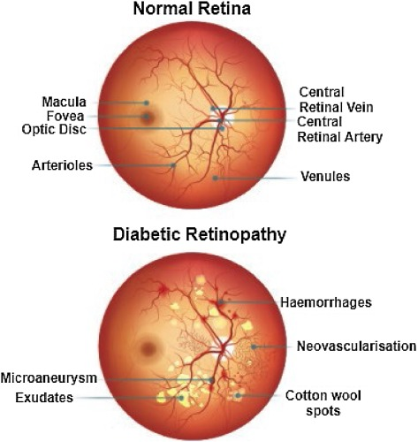
Classification of fundus images for referral
Image-level annotation
Grade DR levels

Slide 33
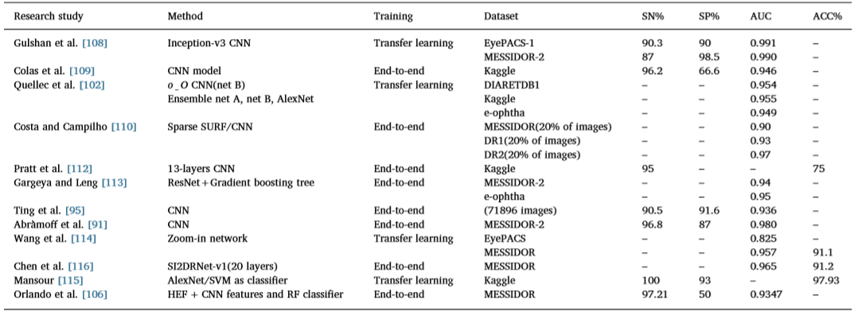
Table 9-Representative of works in diabetic retinopathy(DR) for referral.

Slide 34
Gulshan et al.-sensitivity, specificity and AUC
Gargeya and Leng seems to be robust (ResNet architecture)

Slide 35
Interpreting
Best method CNN
Liskowski and Krawiec(STARE-402 images(38- & 364+)):
SN=85%
Dasgupta and Singh(DRIVE-40 images(33- & 7+)):
SN=76%
Both:
SP=98%
AUC=0.97–0.99
ACC=95–97%.

Slide 36
Problem with CNN
Overfitting
Solution:-
Data augmentation
Transfer learning

Slide 37
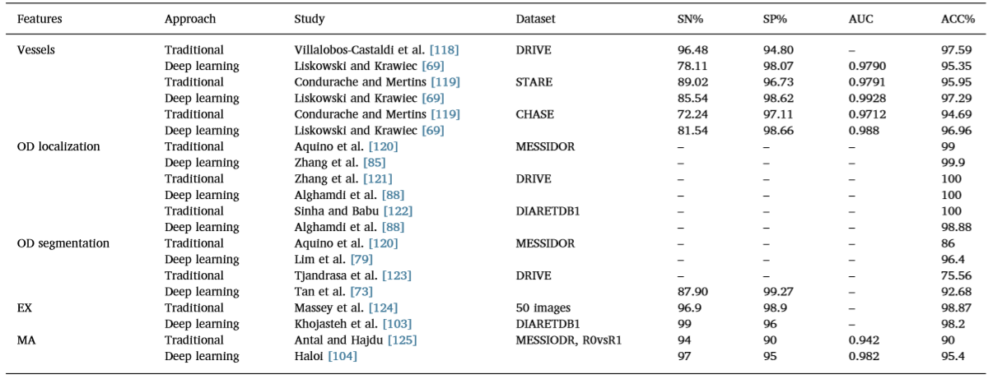
Comparison
Table 10-Comparison between state-of-the-art traditional methods and best-performance deep-learning methods.

Slide 38
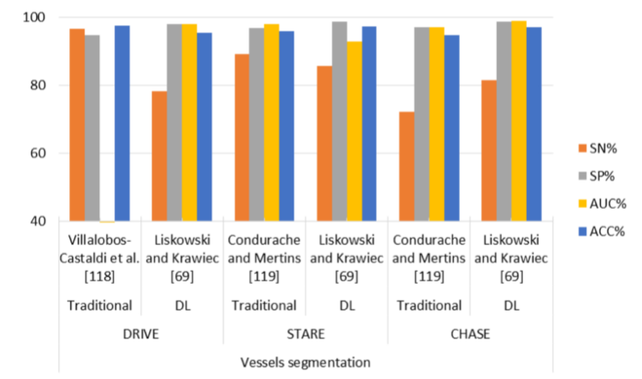
Villalobos-Castaldietal. (sensitivity: 96.48% and accuracy: 97.59%) (DRIVE)
Liskowski and Krawiec (sensitivity: 78.11% and accuracy: 95.35%)(DRIVE)

Slide 39
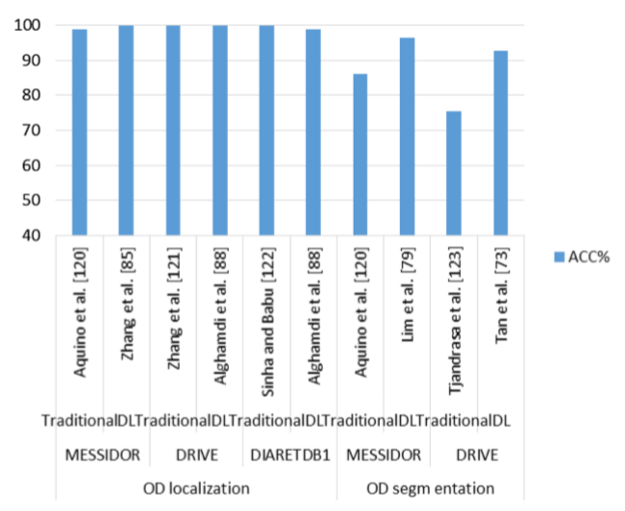

Slide 40
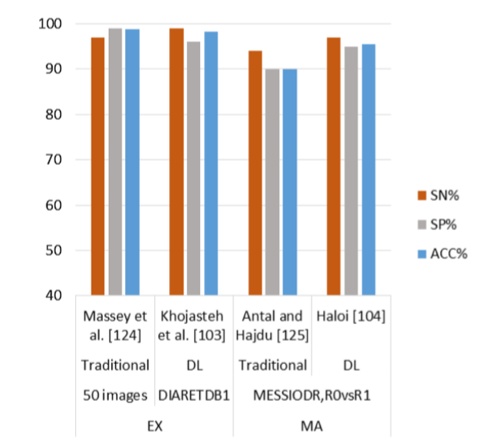
Fig -The plot for maximum performance of MA and EX detection in traditional and DL-based methods.

Slide 41
Challenges
Acquisition of huge volumes of labeled fundus images with pixel- & image-level annotations
Annotation of images-expensive & requires expert ophthalmologists
Solution-
Deep model from limited data
New data augmentation
CNN models-expressive but involve fewer learnable parameters
Class imbalance in datasets
No of DR cases < normal cases
Solution- Generative Adversarial Networks(GANs)
Lack of uniformity among fundus images
problem of illumination
Angle at which light is incident on retina
Same resolution & camera
Pigmentation reflected by iris

Slide 42
Conclusion
More robust and accurate
Many methods for retinal blood vessel segmentation, OD detection and segmentation, detection and classification of different DR lesions, and the detection of referable DR.
Overview of different DR biomarkers and lesions
Overview of datasets
Deep-learning architectures
Comparison
Gaps and weakness

Slide 43
References
📑 Almotiri J, Elleithy K, Elleithy A. Retinal vessels segmentation techniques and algorithms:a survey. Appl. Sci. 2018;8(2):155.
📑 Joshi S, Karule PT. A review on exudates detection methods for diabetic retinopathy. Biomed. Pharmacother. 2018;97:1454–60.
📑 Mansour RF. Evolutionary computing enriched computer-aided diagnosis system for diabetic retinopathy: a survey. IEEE Rev. Biomed. Eng. 2017;10:334–49.

Slide 44
The End

